Slide 1



Review Meeting
January 2018

Slide 2
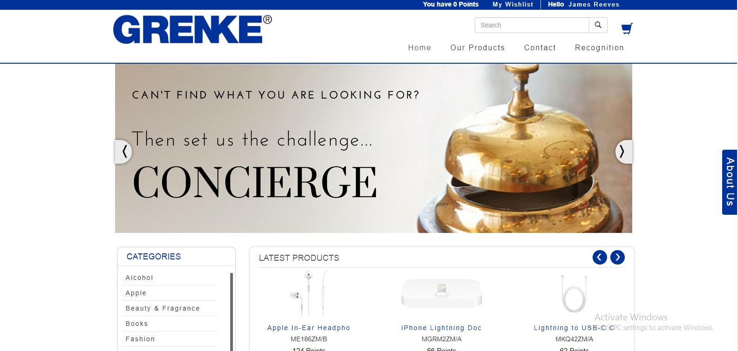
Store

Slide 3
Store Summary

Slide 6
Top Points Holders
FullName | Email | Points | Status | DateAdded
Simon Wood | Simon.wood@documentlogic.co.uk | 14652 | Enabled | 12/12/2017
Richard Wilkins | rwilkins@sitgroup.co.uk | 5285 | Enabled | 6/2/2016
Demot Liddy | sales@b4btelecoms.com | 3395 | Enabled | 2/21/2017
Kevin Bowden | kevin@bowdendigitec.co.uk | 2595 | Enabled | 12/12/2017
Brett Humphreys | Brett.Humphreys@mpsplc.co.uk | 2140 | Enabled | 6/15/2017
Andrew Thompson | andrewthompson@copyprintuk.com | 2009 | Enabled | 3/17/2017
John Burns | john@diamond-group.net | 1832 | Enabled | 10/6/2016
Brian Kidd | bjk@1office.co.uk | 1795 | Enabled | 4/4/2016
Stephen Preston | stephen@mastercopy.co.uk | 1453 | Enabled | 11/2/2015
Luke Rawlins | luke.rawlins@ecotechos.co.uk | 1442 | Enabled | 8/25/2016

